Slide 1

Vehicle Health Analysis and Spare E-Commerce
SRM INSTITUTE OF SCIENCE AND TECHNOLOGY
FACULTY OF ENGINEERING AND TECHNOLOGY
DEPARTMENT OF DATA SCIENCE AND BUSINESS SYSTEMS
18CSP107L- MINOR PROJECT
RA1911027010058
YUVRAJ SINGH CHAUHAN
RA1911027010007
AVINASH REDDY VASIPALLI
Guide name: T. KARTHICK
Designation: Assistant Professor
Department: DSBS

Slide 2

Table of Contents
S.NO | TITLE | Slide No
1 | ABSTRACT | 3
2 | INTRODUCTION TO PROJECT | 4
3 | PROBLEM STATEMENT & OBJECTIVE | 5
4 | PROPOSED METHODOLOGY | 6
5 | ARCHITECTURE/BLOCK DIAGRAM | 7
6 | ALGORITHM USED | 8
7 | INTERMEDIATE RESULT AND DISCUSSION | 9
8 | MODULES DESCRIPTIONS | 12
9 | PYTHON LIBRARIES | 13
10 | SOURCE CODE IMAGES | 14
11 | OUTPUT-DEMO OF THE PROJECT | 15
12 | REFERENCES | 17

Slide 3
Abstract
In many automobile industries, predictive maintenance and insurance premium has become more important. It is hard to diagnose failure in advance in the vehicle industry because of the limited availability of sensors and some of the designing exertions. However, it looks feasible today to analyze sensor’s data along with machine learning techniques for failure prediction.
The main objective is to find insurance premium of vehicles by analyzing the health condition of the vehicle. With modern techniques is all serveries are available online. Thanks to advancement in technology concepts or ideas once thought we impossible or laughed at are now possible in mere second. It was thought impossible to send letters in a day but now we can talk and see people who are far away. But even now some areas in our country relay on old methods to pay their insurance by approaching a agent.
Not every person is creditable when it comes to money which is true as many people pay excessive insurance because of their lack of knowledge. One more problem is the repair cost that threaten people. When we find our vehicle with some issue we approach mechanics and what they tell us is final as we don’t know what the issue so we pay as much as demanded to get our vehicle back.
But with this project we hope to solve these problems.

Slide 4
Introduction to project
The rising need for people and independent retailers to access more affordable automotive parts for sale in the aftermarket offers an impetus to the market.
Vehicle systems are complex both in hardware and software so their maintenance is challenging.
Maintenance strategy being used in vehicle industry is normally reactive that results in reduction of lifetime of vehicle and also loss of money, thus predictive maintenance is required on this stage to overcome these issues.
This ongoing trend of pure-play retailers deploying e-commerce strategies is projected to fuel the growth of the market.
Insurance payment is becoming a big burden to people who bought a new vehicle or second hand. Agents make premiums high that is scaring the owners to take insurance.
Not only the reasons stated are irrelevant sometimes the technical terms these agents makes owner pay high amounts.

Slide 5
Problem statement & objective
Problem Statement:
A system that analysis data of vehicles like its age, distance travelled, millage, strokes, Horse power and other attributes to determine the heath of the vehicle. Which helps the system estimate the insurance amount and provides a value that is affordable by the owner of the vehicle.
Objective:
Analyze the information such as distance travelled since the time it is active, years used, model of car, and other factors to estimate the insurance amount to be paid and give maintenance alerts if required.
Estimate the insurance claim that would be received by the customer due to faults caused by some unforeseen circumstances.

Slide 6
Proposed Methodology
Prediction of value for insurance of the vehicle can be done by analysing the data using different algorithms. For the predictor we are using basic algorithm namely Liner Regression with the data given like milage, distance travelled, horse power and many other details. These data are plotted against each other and a value is decided according to the vehicle health.
This application is used to predict a possible price for vehicle to be paid for their insurance . This uses the data across 20k plus data samples and provide the insurance amount that could be paid.
This application is used to predict a possible price for a second hand motorbike in India. The application uses a preloaded bikes data which spans across 30k plus data samples of used bikes and their prices of sell, 23 companies and multiple features to decide the best possible price.
Even though the value could not be 100% accurate the value is estimated after a through analysis of data and could be improved with new algorithm introduced and training the machine with new data.
Tech Stack:
Python 3.9 for logic development
Streamlit for UI integrations
share.streamlit.io for hosting

Slide 7
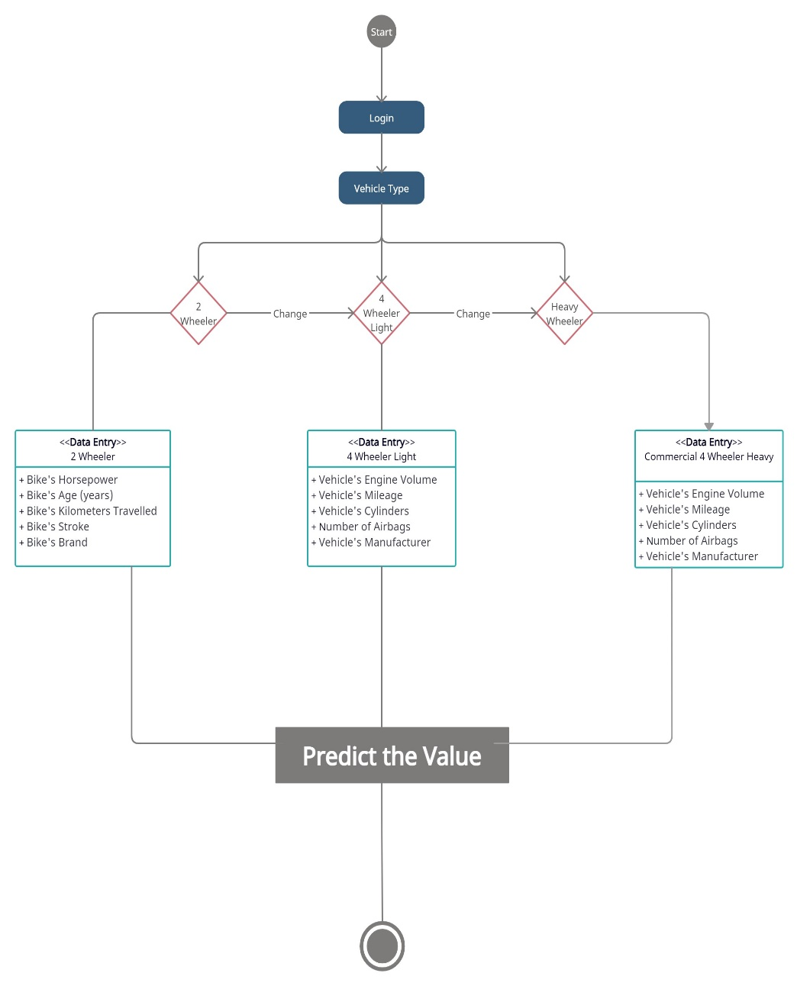
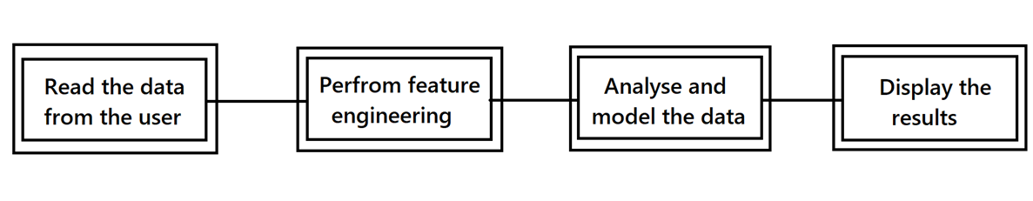
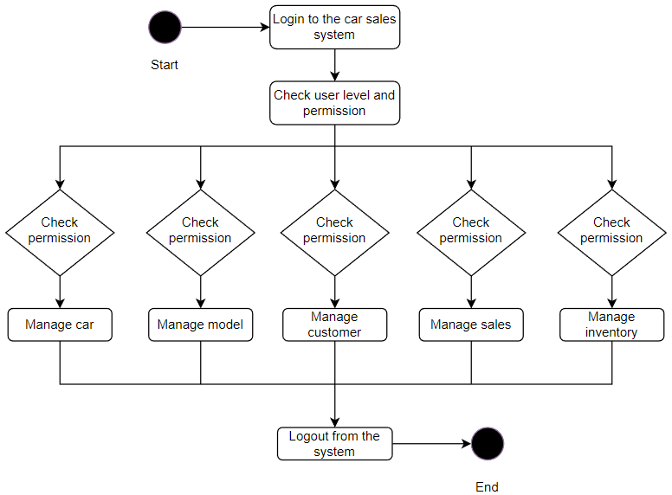
Architecture/block diagram

Slide 8
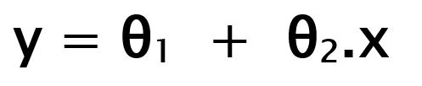
Algorithm Used
Liner Regression
Linear Regression is a machine learning algorithm based on supervised learning. It performs a regression task. Regression models a target prediction value based on independent variables.
Linear regression performs the task to predict a dependent variable value (y) based on a given independent variable (x). So, this regression technique finds out a linear relationship between x (input) and y(output).
While training the model we are given : x: input training data (univariate – one input variable(parameter)) y: labels to data (supervised learning)
When training the model – it fits the best line to predict the value of y for a given value of x. The model gets the best regression fit line by finding the best θ₁ and θ₂ values. θ₁: intercept θ₂: coefficient of x
Once we find the best θ₁ and θ₂ values, we get the best fit line. So when we are finally using our model for prediction, it will predict the value of y for the input value of x.

Slide 9
Intermediate Result And Discussion
Dataset for this project was a big problem as many sites did not have a proper arranged data sets for analysis. Some had name and value while some had distance travelled but no other attribute. In this process there was a point where insufficient data was available for the machine to work, wherein prediction was not as expected.
After a thorough search and time we could find a dataset that could work with the analysis where it had horse power, milage, stokes and other import elements for a vehicle’s engine
When it comes to results, with the use of liner regression it was always possible for negative values which implies they are not worth insurance or the vehicle health was bad.
These cases occurred frequently during the data analysis and prediction time which took a lot of time
Even though the value is predicted, with more data on vehicle and previous insurance issued for those along with extra attributes can really help the machine provide more accurate value
Also use of other algorithms like SVM, logistic regression, Decision tree, KNN, K-mean
can provide more insights on these prediction of value.

Slide 10
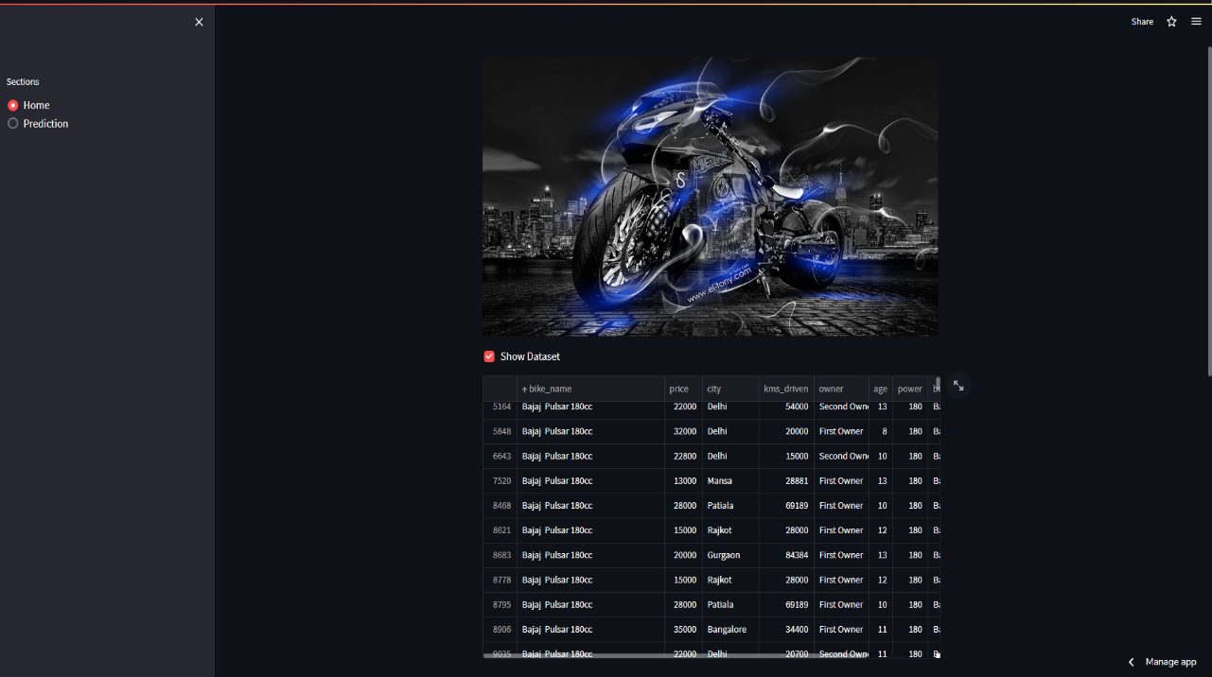
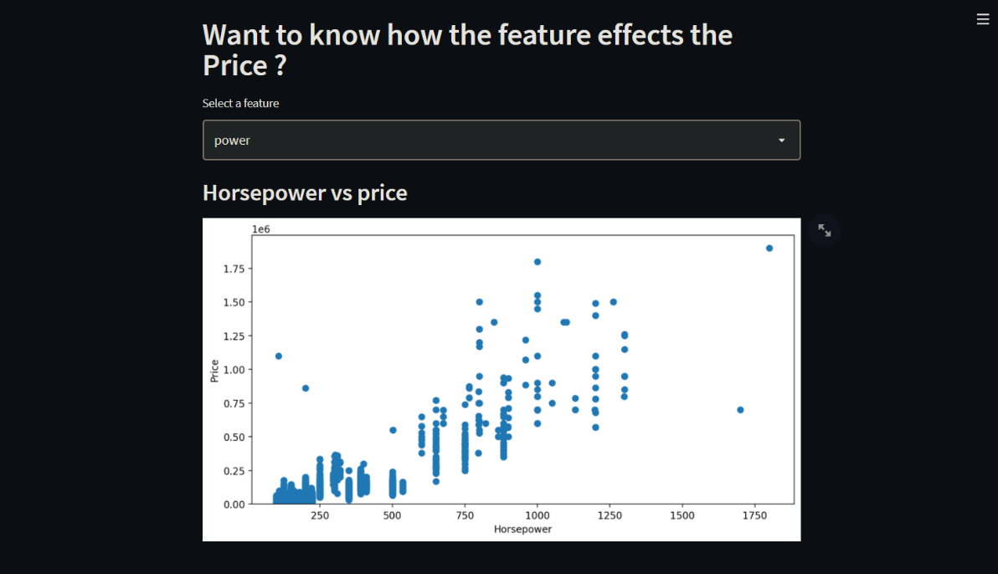
Links - Second hand Bike value Predictor
GitHub
Home page and Dataset
Data Visualization of dataset

Slide 11
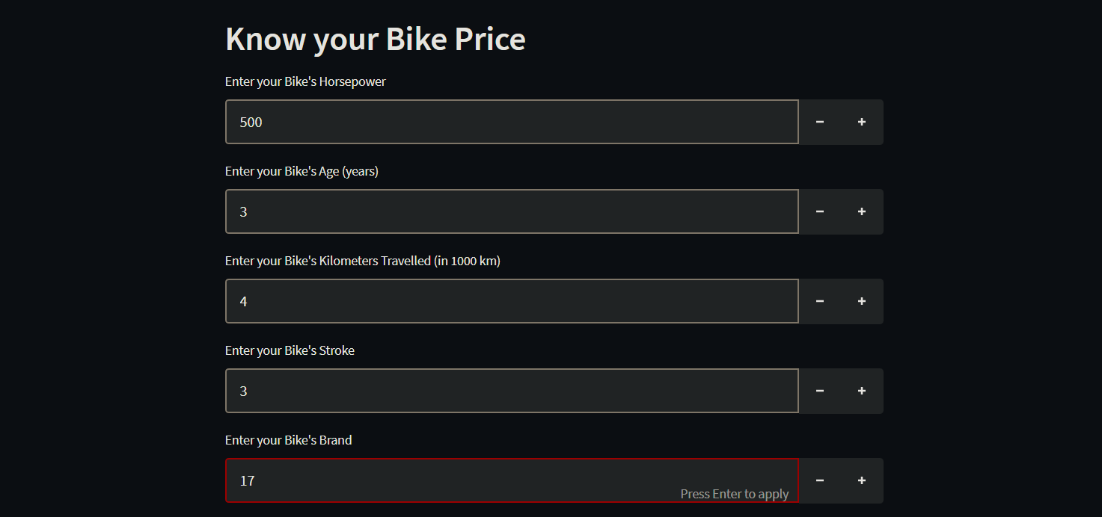
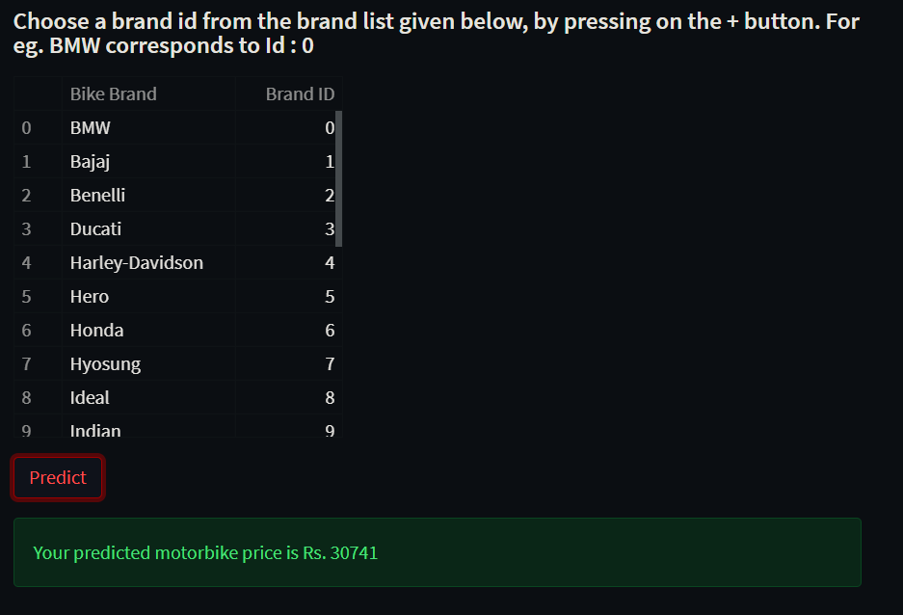
Data Entry for analysis
Price prediction

Slide 12

Modules Descriptions
Module 1: Data Integration
Data from a excel is integrated to the machine for data analysis. This data is then pre-processed using LabelEncoder(). Data of vehicles with attributes like engine volume, Mileage, Distance travelled, Horse Power, Stokes, Airbags, Bike company are integrated in to representing as a graph.
Module 2: ML Algorithm
Using python libraries we integrate ML algorithms like SVM, Liner regression and many others to analysis the data. In this project we used only liner but other algorithms are also possible in which we can predict the values but making a slight change in the source code.
Module 3: Value prediction and visualization
In this module we have data visualization when in graphs are being introduced to show relation between the attributes but plotting the graphs using matplotlib library. And using ML we predict the value to be paid as well. This prediction is selected by analysis of the data in the CSV files we integrated.

Slide 13
Python Libraries
For the prediction of insurance amount and second hand vehicle cost we can use Machine learning algorithms. For this to apply on data sets we need python libraries like
Streamlit is an open source app framework in Python language. It helps us create web apps for data science and machine learning in a short time.
Pandas is an open source Python package that is most widely used for data science/data analysis and machine learning tasks.
NumPy is a Python library used for working with arrays. It also has functions for working in domain of linear algebra, Fourier transform, and matrices.
Matplotlib is a comprehensive library for creating static, animated, and interactive visualizations in Python.
Pyplot is an API (Application Programming Interface) for Python's matplotlib that effectively makes matplotlib a viable open source alternative to MATLAB
Sklearn contains a lot of efficient tools for machine learning and statistical modeling including classification, regression, clustering and dimensionality reduction.

Slide 14
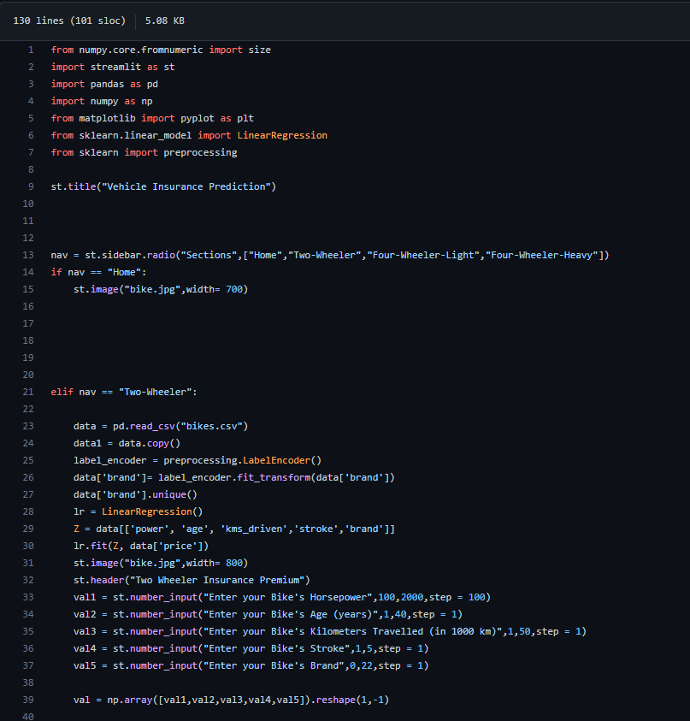
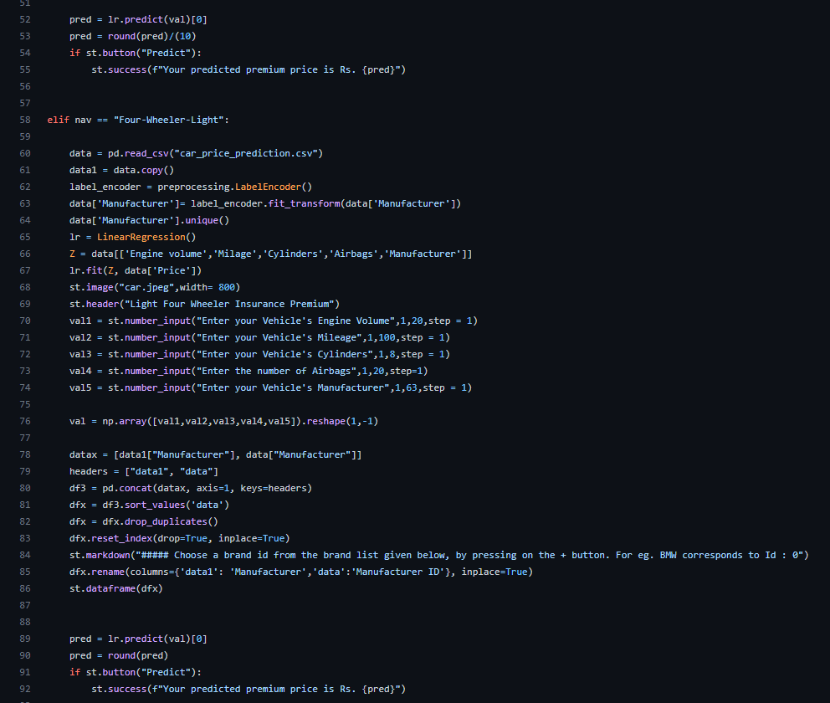
Source code Images
GitHub

Slide 15
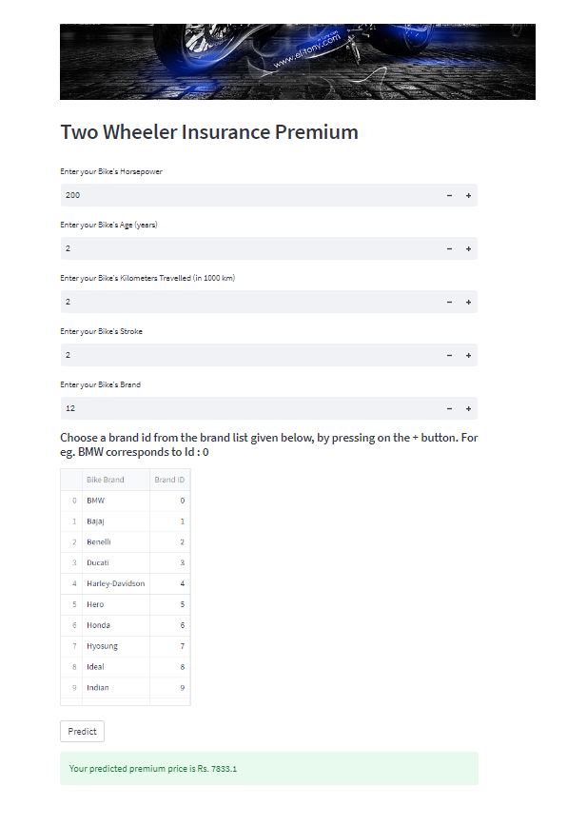
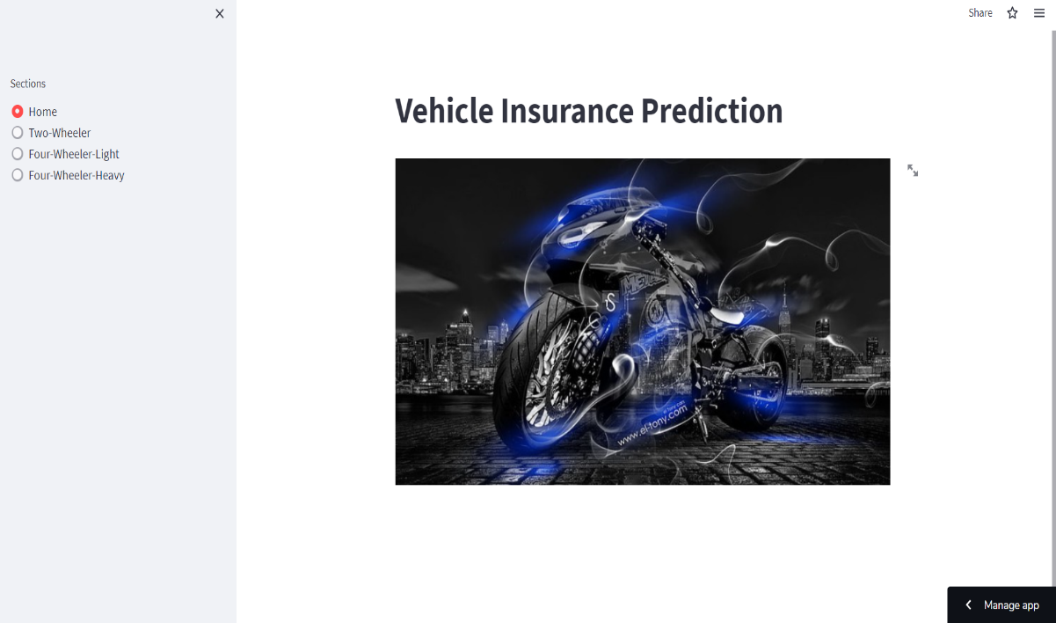
Output-demo of The Project
By using ML algo we analysed the data and integrated it to UI design as shown above. In right, image shows the prediction of premium for the bike data entered.
Link - Vehicle Health Analysis and Insurance Predictor

Slide 16
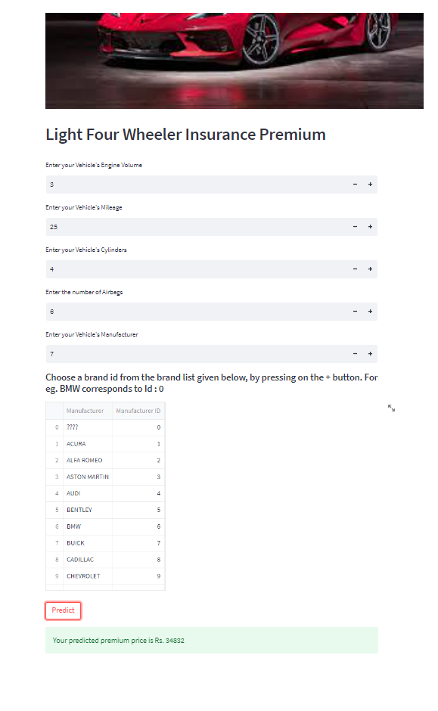
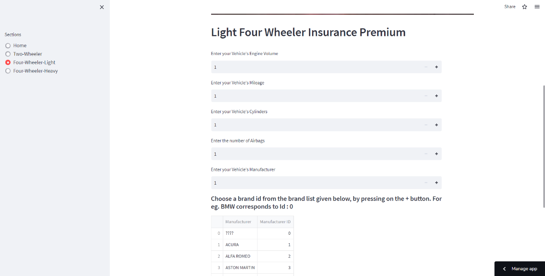
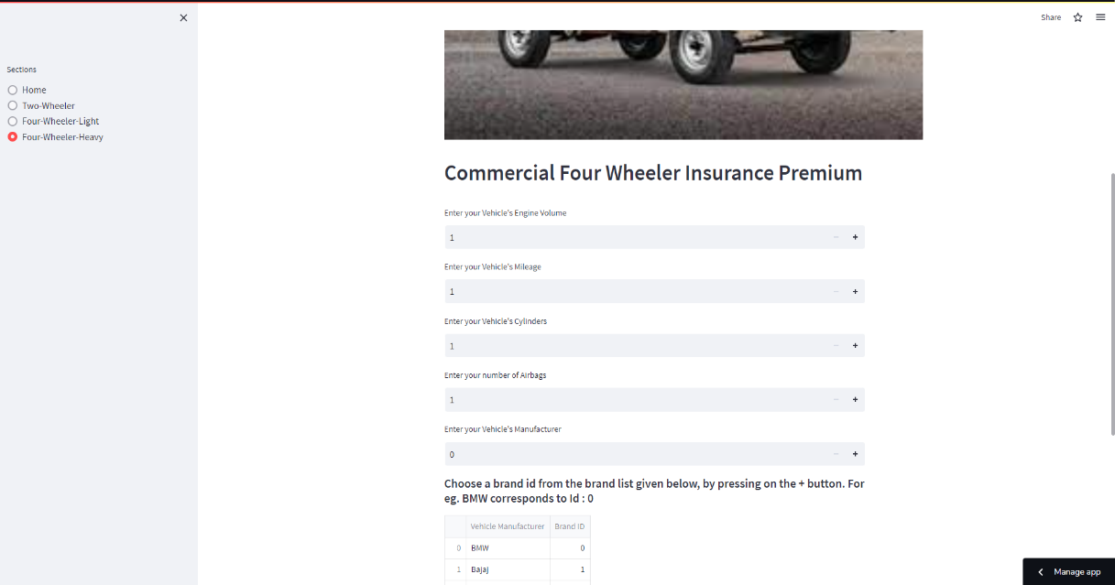
Some Additional Images

Slide 17
REFERENCES
A study on car insurance purchase prediction using machine learning Shwetha Shree K*1, Mohan Murali P*2 (2022)
Machine Learning Approaches for Auto insurance Big Data, Mohamed Hanafy, Ruixing Ming (2021)
Vehicle Health Monitoring and Analysis May 2016, Parmesh K. R
A Vehicle Health Monitoring System Evaluated Experimentally on a Passenger Vehicle October 2006, Hok K. Ng, Robert H. Chen, Jason Speyer
Motor Insurance Claim Status Prediction using Machine Learning Techniques, Endelew Alamir, Teklu Urgessa, Ashebir Hunegnaw, Tiruveedula Gopikrishna
Prediction of motor insurance claims occurrence as an imbalanced machine learning problem Sebastian Baran, Przemys law Rola (2022)
A proposed model to predict auto insurance claims using machine learning techniques, shady abdelhadi, khaled A. Elbahnasy, mohamed M. Abdelsalam

